Slide 1
Tanzania Association of Tour Operators - TATO
NYERERE DAY,
14th October 2022

Slide 3
ACTION NOT EXTINCTION (anti-poaching song commissioned by Tanzania Association of Tour Operators-TATO)
-------
Copyright (c) Tanzania Association of Tour Operators - TATO, 2014,
all rights reserved.
Text and idea by TATO.
Speech Mwalimu Julius K. Nyerere, Baba wa Taifa.
Music and arrangements by David Senge'nge/Issai Mashingo.
Instruments: guitar David Senge'nge, bass guitar Exel Haonga, violin Raymond David, djembe drumming David Seng'enge.
Backup vocal: David Senge'nge.
Opening & closing words: Catherine David.
Produced by Exel Haonga at Makumira University Studio Tanzania.

Slide 4
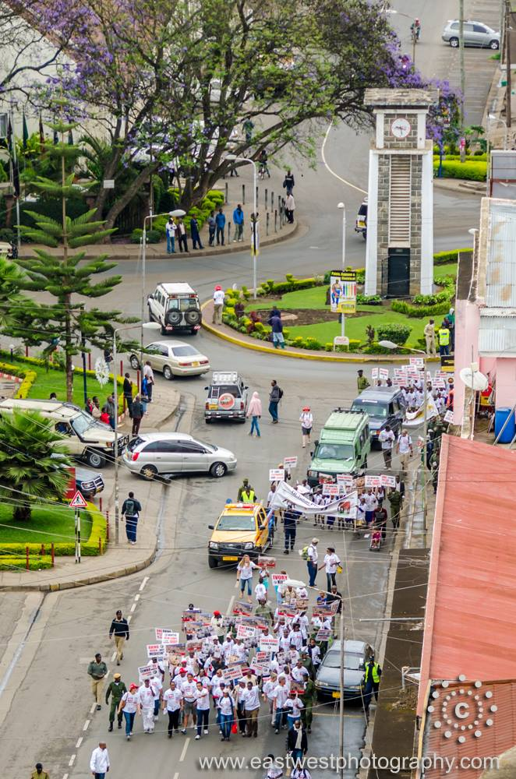
ACTION NOT EXTINCTION (cont’d)
Child: Wanyama wetu wanauwawa tembo wetu wanatoweka sisi watoto tutarithi nini?
VERSE 1
Stop the killing stop the illegal trade,
Elephant the lands’ biggest mammal is about to fade away, (2)
Thousands of them massacred each year,
It is time their cry we hear! (2)

Slide 5
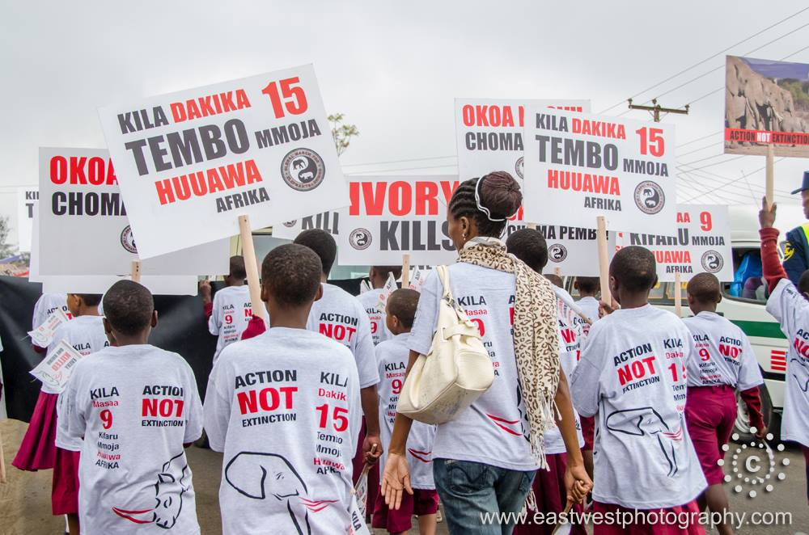
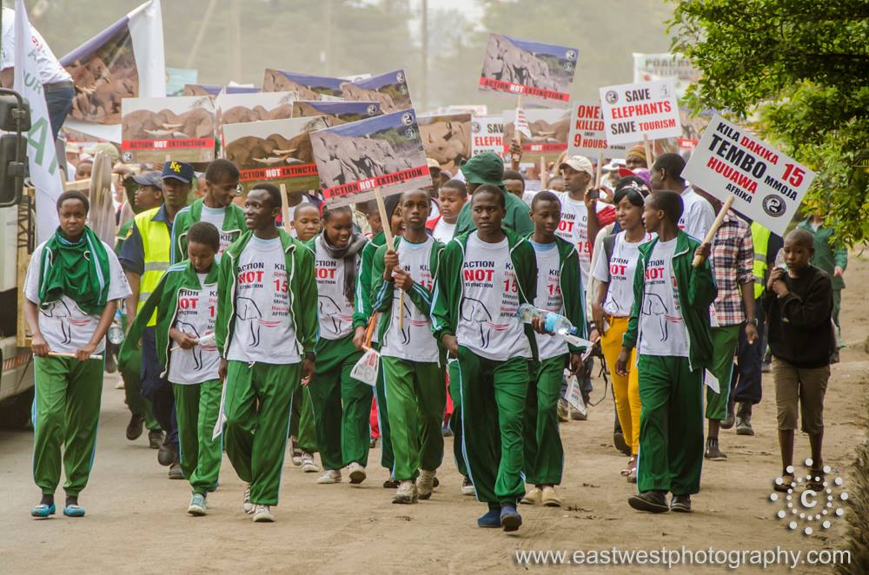
ACTION NOT EXTINCTION (cont’d)
CHORUS
Tanzania we must choose action NOT extinction,
Our wildlife is endangered and not really free,
Tanzania tuchague tembo au mbuga zisizo na kitu,
Kwa kuua wanyama wetu twapoteza urithi wa kizazi kijacho,(2)

Slide 6
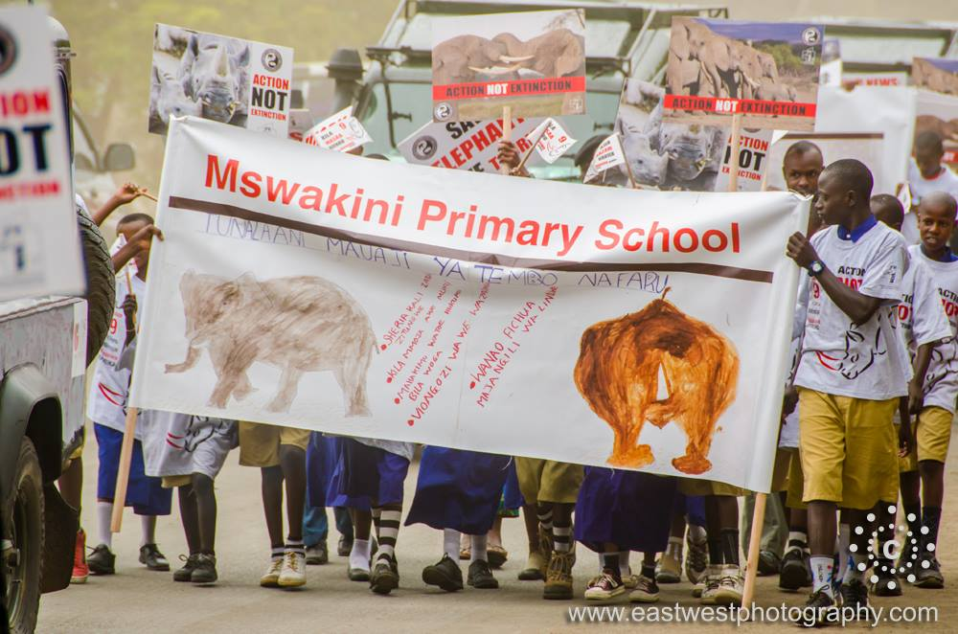
ACTION NOT EXTINCTION (cont’d)
VERSE 2
Remember the Arusha manifesto,
Written by the father of the nation,
He signed a declaration,
Tukumbuke azimio la Arusha alilotoa baba wa taifa,
Kuzilinda hifadhi zetu kuwalinda wanyama wetu,

Slide 7
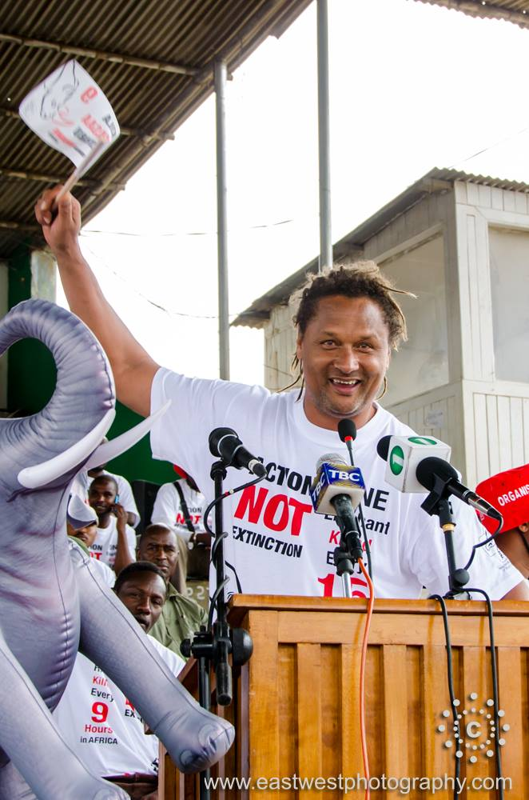
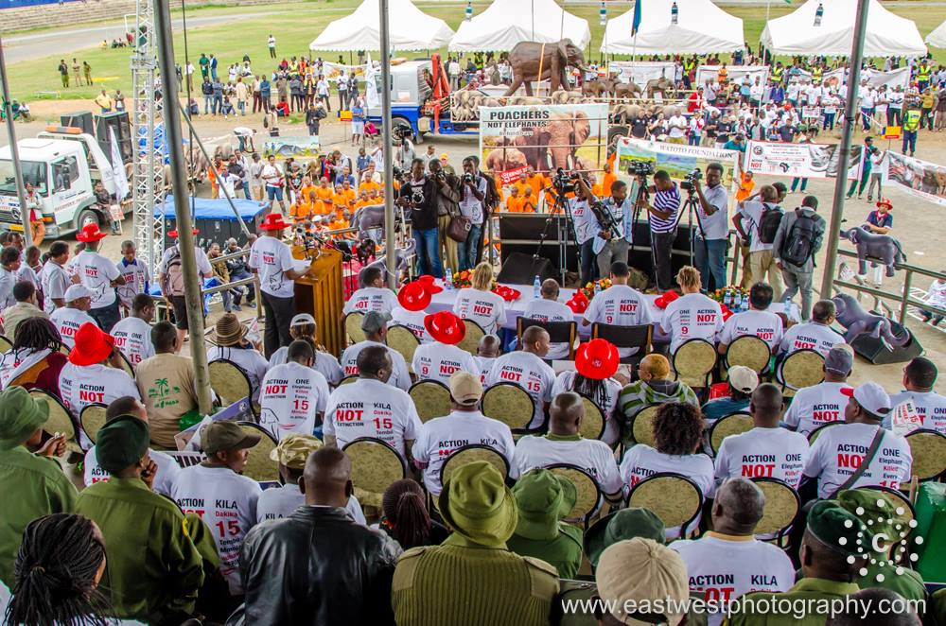
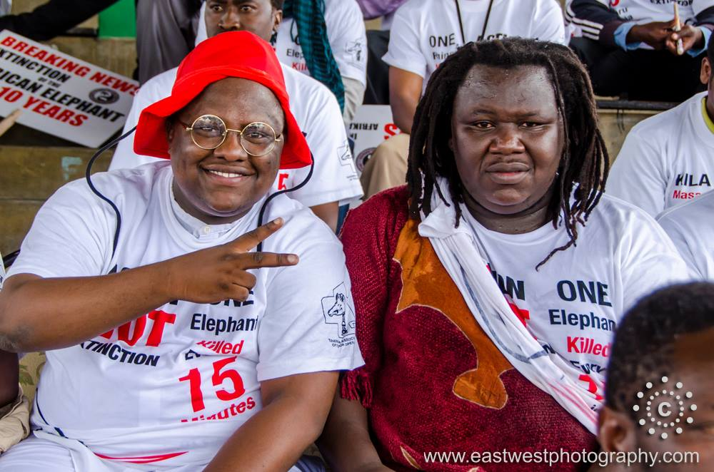
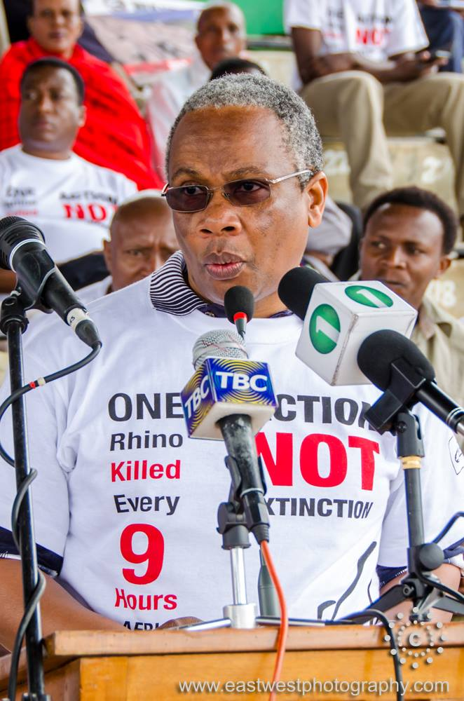
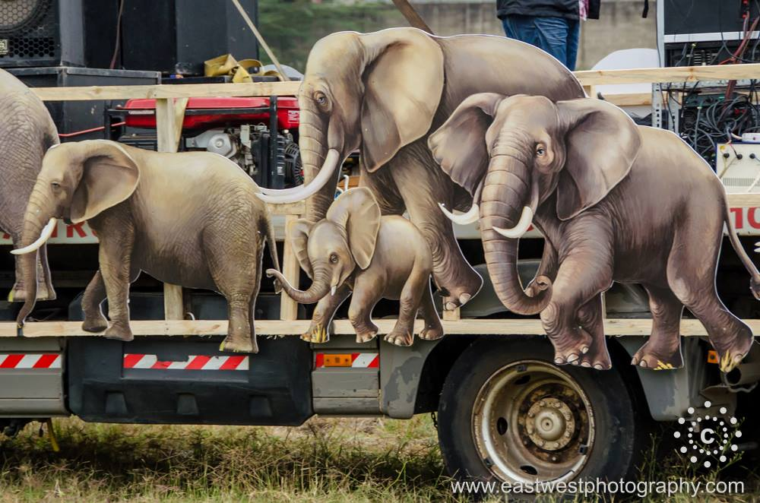
ACTION NOT EXTINCTION (cont’d)
CHORUS
Tanzania we must choose action not extinction,
Our wildlife is endangered and not really free,
Tanzania tuchague tembo au mbuga zisizo na kitu,
Kwa kuua wanyama wetu twapoteza urithi wa kizazi kijacho,(2)

Slide 8
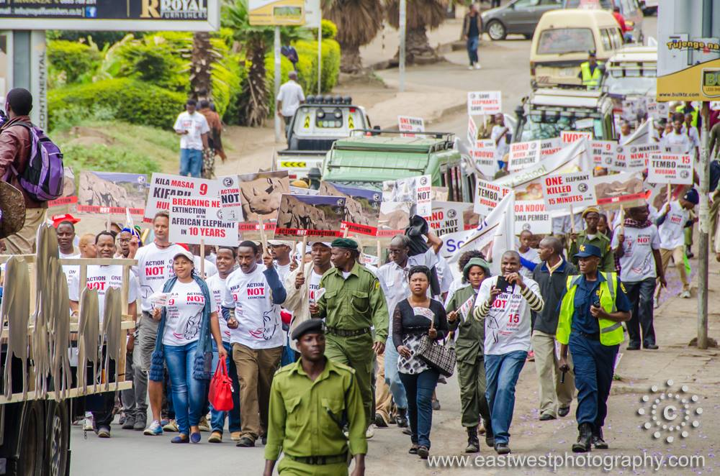
ACTION NOT EXTINCTION (cont’d)
BRIDGE
Tanzania see our plight and join us in this fight (4)

Slide 9
ACTION NOT EXTINCTION (cont’d)
Child : Tukumbuke maneno aliyosema baba wa taifa Mwalimu Julius Nyerere
NYERERE SPEECH
Tunayo maeneo ya hifadhi ambayo yanahifadhiwa kisheria,
Ambayo sasa tumeanza kulegeza ule ulinzi wake,
Sasa nadhani kazi ya kwanza kabisa ambayo serekali lazima ifanye,
Na humu wamo viongozi wetu wa serekali za mitaa,
Ni kukaza amri sheria zile zipo kwamba maeneo yale,
Ambayo yanahifadhiwa kwa mujibu wa sheria yaendelee kihifadhiwa
Kwa mujibu wa sheria na yeyote atakaye vunja sheria tupambane nae
Kwasababu anatufanyia jambo jambo la dhambi kabisa jambo baya kabisa

